Slide 1
Uncertainty Quantification of Agent-based Models with Application to Malaria Intervention Modeling
PhD Update
August 2025

Slide 2
Research Question
At what coverage level does each malaria intervention (LLINs, IRS, SMC, malaria vaccine) begin to provide community-level protection?

Slide 3
Community protection
Indirect effects can be defined as the unintended positive or negative consequences of an intervention that influences disease transmission or health outcomes.
Community protection: A reduction in infection prevalence among individuals not receiving the intervention due to lowered transmission in the community.
Goal: To identify the minimum intervention coverage at which a significant decline in prevalence among non-recipients / non-users is observed
If there is no community protection, prevalence remains flat in the non-intervention group / non-recipients
If there is community protection, prevalence starts to decrease
The steeper the drop, the stronger the community protection
Identify the coverage level at which prevalence in non-recipients begin to drop

Slide 4
Impact prediction using GP emulator
Using existing simulation output
Fix all other inputs (LLIN, IRS, Vaccine) at their aspirational values.
Vary SMC coverage from 0.2 to 1.0 (to match GP training range).
Predict the impact (incidence reduction) using the GP

Slide 5
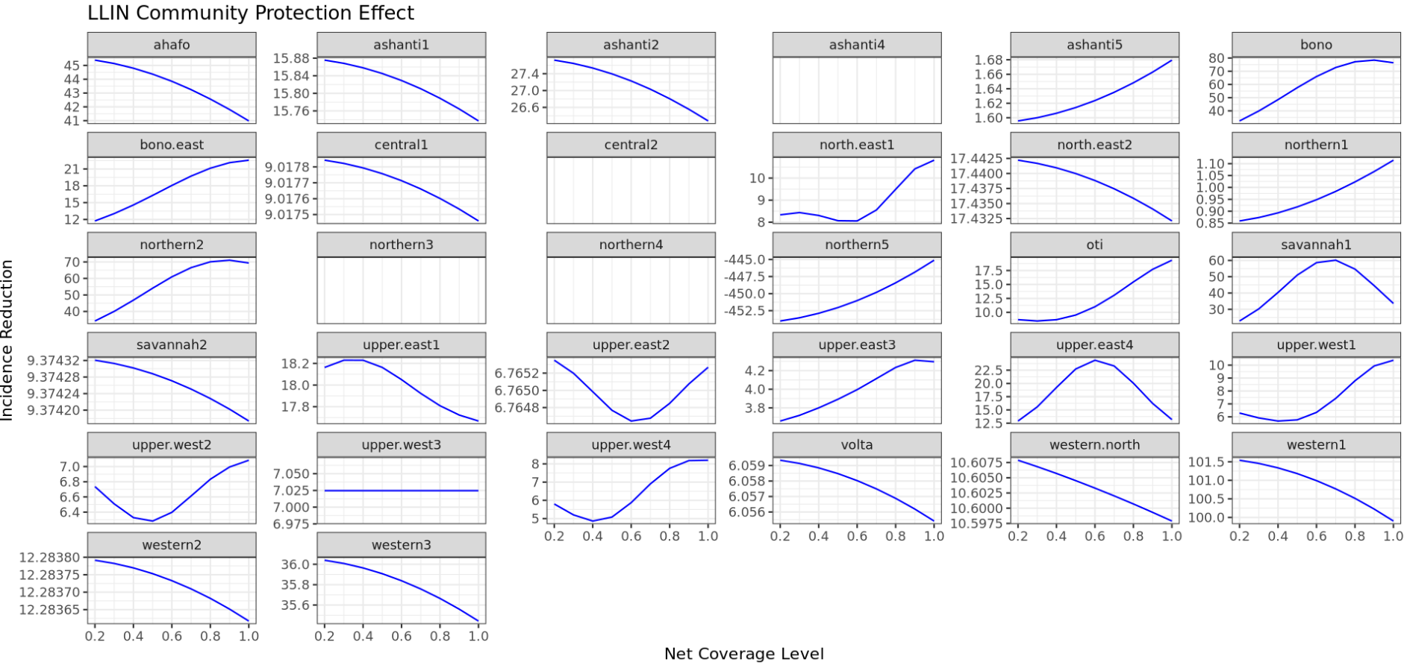
LLIN

Slide 6
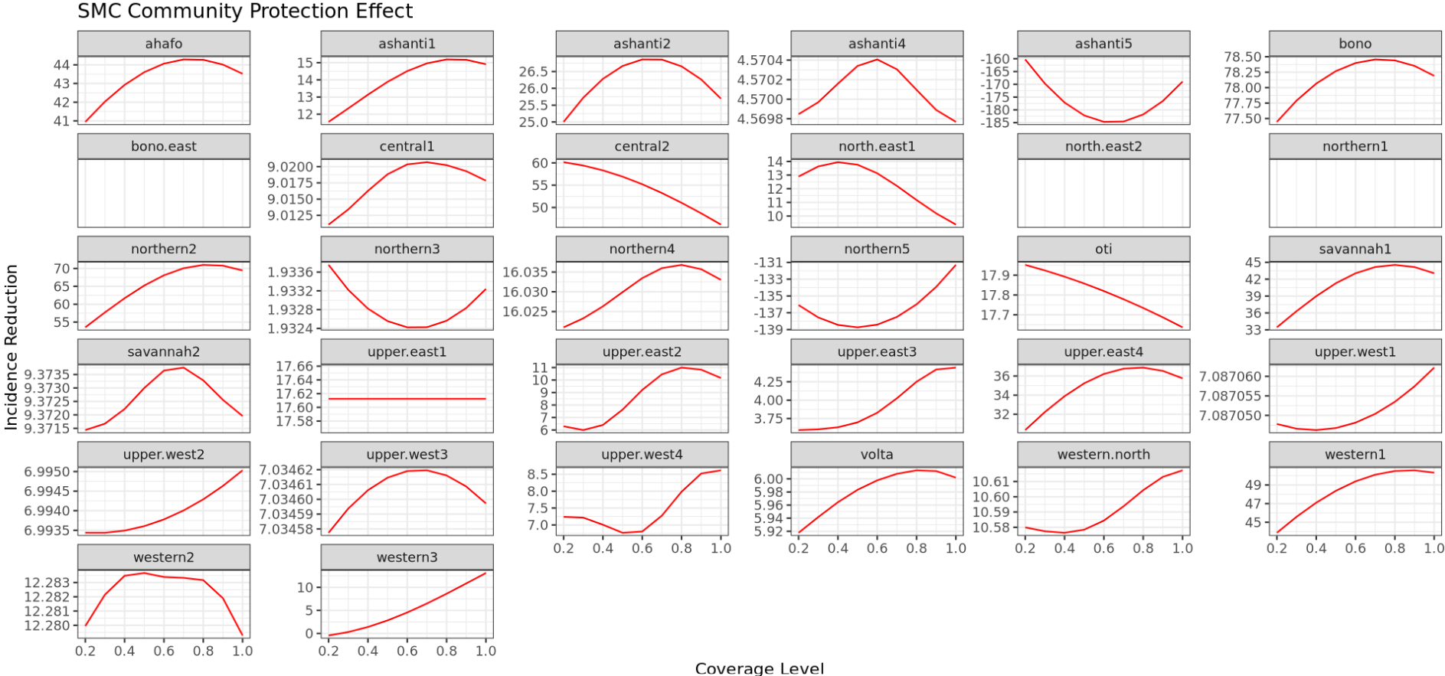
SMC

Slide 7
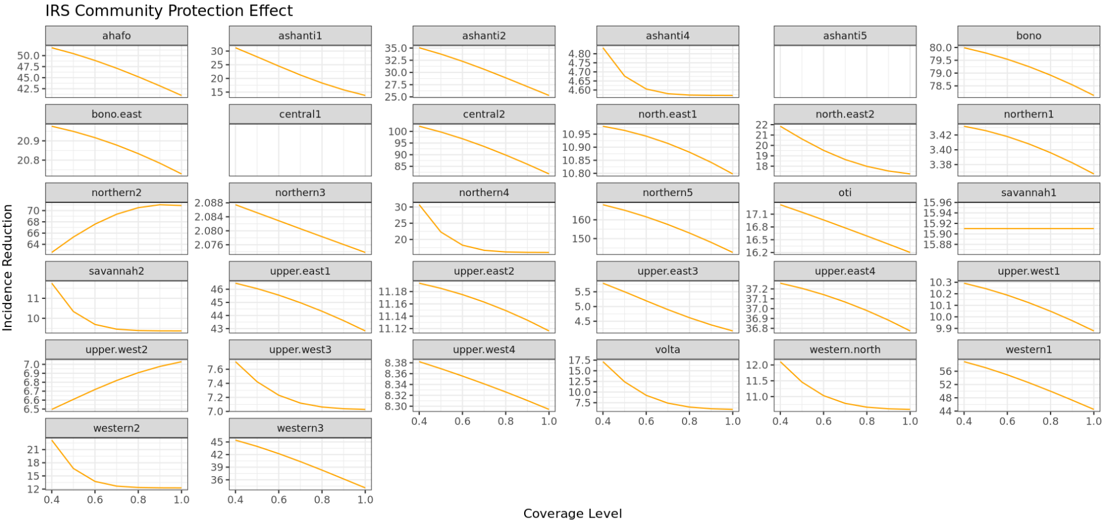
IRS
Notes:
To address uncertainties, we identify and quantify the various sources of uncertainty in intervention modeling

Slide 8
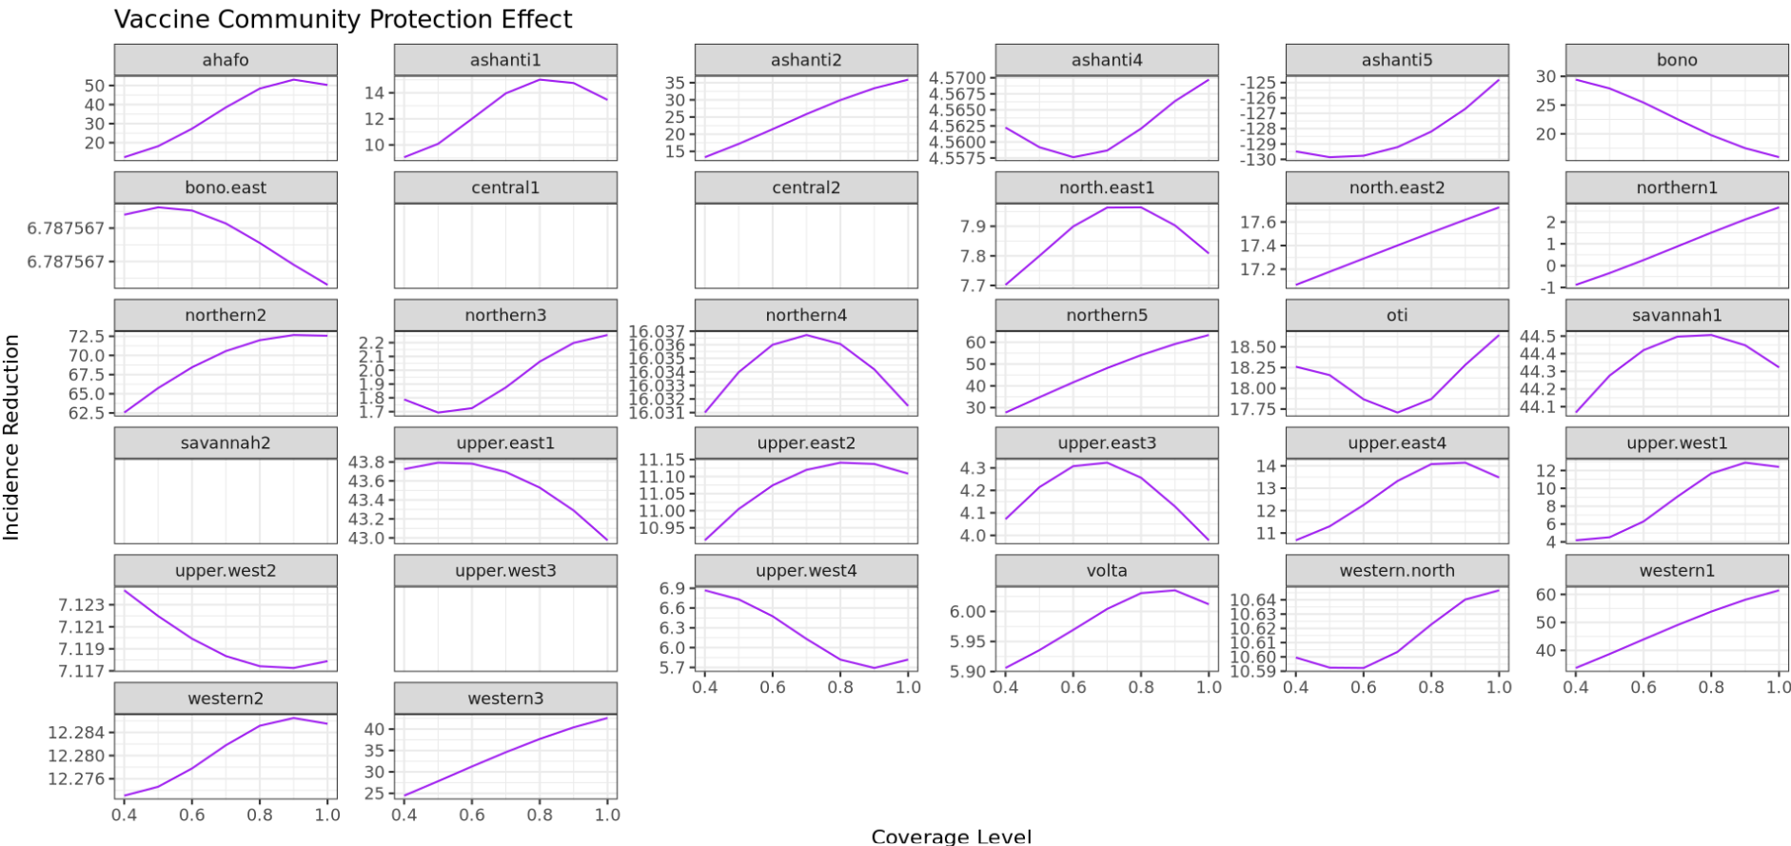
Vaccine

Slide 9
Community protection - Challenges
Retrained GPs on nSevere, nUncomp and incidence rate to predict impact
To study community effects, I need scenarios where a subset of the population is explicitly excluded from the intervention, but still experiences the reduced transmission from those who are covered.
Clearly defined cohorts (recipients and non-recipients)
Study transmission dynamics within cohorts
AIMS – Ghana Office – new policy

Slide 10
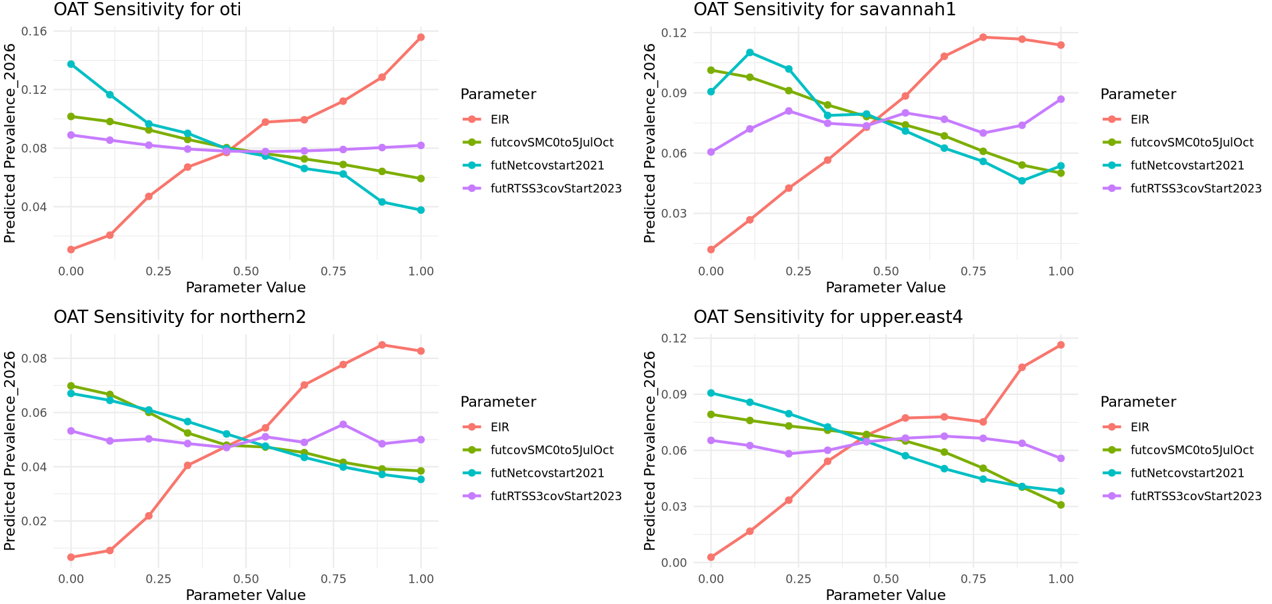
One-at-a-time Sensitivity analysis for some settings

